Slide 1

MALLA REDDY COLLEGE OF ENGINEERING & TECHNOLOGY (Autonomous Institution – UGC, Govt. of India) DEPARTMENT OF COMPUTER SCIENCE AND ENGINEERING
BRAIN TUMOR DETECTION
Under the Guidance of
Name: Ms. K. Chandusha
Designation: Asst. Professor
Batch No: C1
Pyla Thrisha 22N31A05K0
Mandra Navya 22N31A05D3
Piyush Samanta 22N31A05H6

Slide 2
AGENDA
Abstract
Introduction
Existing system
Proposed system
Software and Hardware Requirements
Literature survey
System architecture(Modules Explanation)
UML Diagrams
Technologies Used
Module Description
Output Screens
Conclusion
Future Scope

Slide 3
Abstract
Brain tumor detection is a critical medical challenge that necessitates accurate and timely diagnosis to improve patient outcomes. This study explores advanced methods for brain tumor detection using machine learning techniques. We employed a comprehensive dataset of MRI scans and applied convolutional neural networks (CNNs) to enhance detection accuracy. The proposed model was trained and validated using extensive data augmentation and preprocessing techniques to handle the variability in MRI scans. Our results demonstrate a significant improvement in tumor detection accuracy compared to traditional methods, highlighting the potential of AI-driven approaches in clinical diagnostics. Furthermore, the model's performance was evaluated using various metrics such as precision, recall, and F1-score, showcasing its robustness and reliability. This research contributes to the growing field of medical imaging and offers a promising tool for early and accurate brain tumor detection.

Slide 4
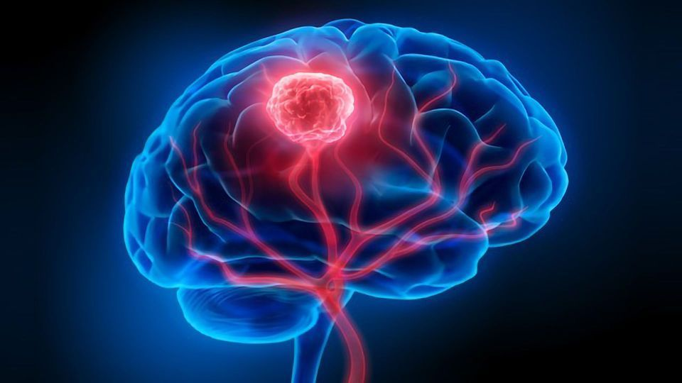
Introduction
Brain tumors are abnormal growths of cells within the brain or its surrounding tissues, which can be either benign (non-cancerous) or malignant (cancerous).
Early detection and accurate diagnosis of brain tumors are critical for effective treatment and improving survival rates and patient outcomes.
Medical imaging techniques such as Magnetic Resonance Imaging (MRI) and Computed Tomography (CT) scans are the standard tools used for detecting brain tumors.
The manual analysis of these medical images by radiologists is time-consuming, prone to human error, and requires a high level of expertise.
Therefore, there is a growing need for automated systems that can assist in the detection and diagnosis of brain tumors.

Slide 5
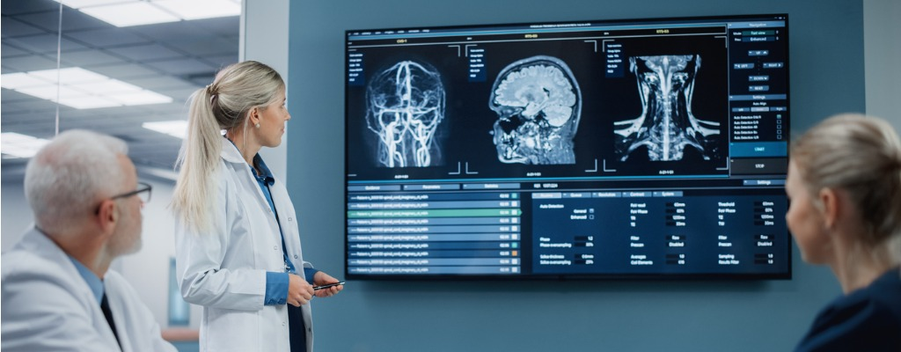
Existing system
The existing systems for brain tumor detection primarily rely on manual interpretation of MRI or CT scans by radiologists. These systems have several limitations:
Manual Interpretation
Limited Accuracy
High False Positives/Negatives
Lack of Standardization

Slide 6
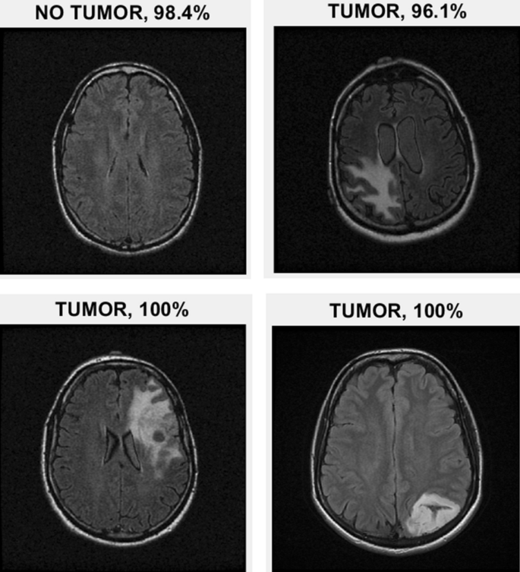
Proposed system
The proposed system aims to address the limitations of existing brain tumor detection methods by utilizing advanced machine learning techniques. The system would work as follows:
Automated Image Processing
Improved Accuracy
Faster Diagnosis
Consistency
Continuous Learning and Improvement

Slide 7
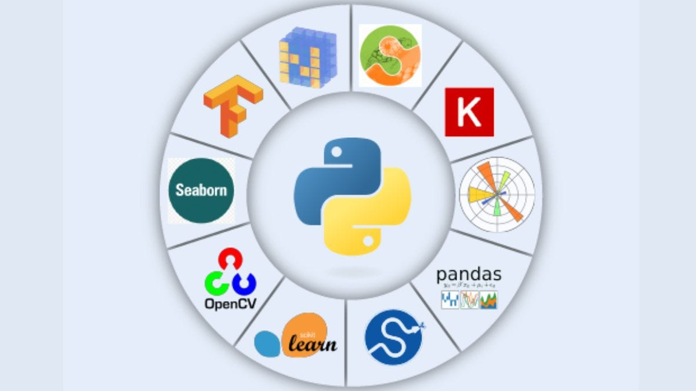
Software Requirements
Operating System: Windows 10+ / Ubuntu 18.04+
Programming Language: Python
Frameworks: TensorFlow, Django, Scikit-learn
Libraries: OpenCV, Matplotlib, NumPy, Pandas
Version Control: GIT
Integrated Development Environment(IDE): Visual Studio Code

Slide 8
Hardware Requirements
RAM: 16 GB minimum (32 GB recommended for larger datasets)
Processor: Intel Core i5+ / AMD Ryzen 5+
Graphics Processing Unit (GPU): NVIDIA GTX 1060 Ti+
Storage : SSD- Minimum 256 GB

Slide 9
Literature Survey
S.No | Author(s) & Journal Details | Title of the paper | Outcome
1. | Author: Luxit Kapoor, Sanjeev Thakur Journal Name: IEEE 7th International Conference on Cloud Computing, Data Science & Engineering | A Survey on Brain Tumor Detection Using Image Processing Techniques | This paper reviews key techniques in Medical Image Processing for detecting brain tumors in MRI images, highlighting segmentation as the most crucial step.
2. | Author: Praveen Gamage Journal Name: Research gate | Identification of Brain Tumor using Image Processing Techniques | This paper categorizes brain tumor identification from MRI images into four sections: pre-processing, segmentation, feature extraction, and classification.
3. | Author: Deepa, Akansha Singh Journal Name: IEEE International Conference on Computing for Sustainable Global Development | Review of Brain Tumor Detection from MRI Images | This paper reviews recent research on brain tumor detection and segmentation, outlining various MRI-based techniques. Automation in this field is identified as a highly active research area.

Slide 10
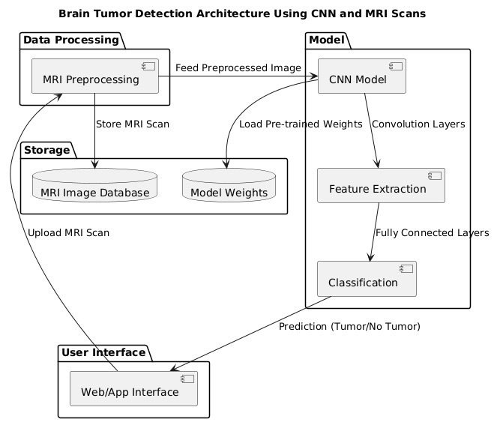
System Architecture

Slide 11
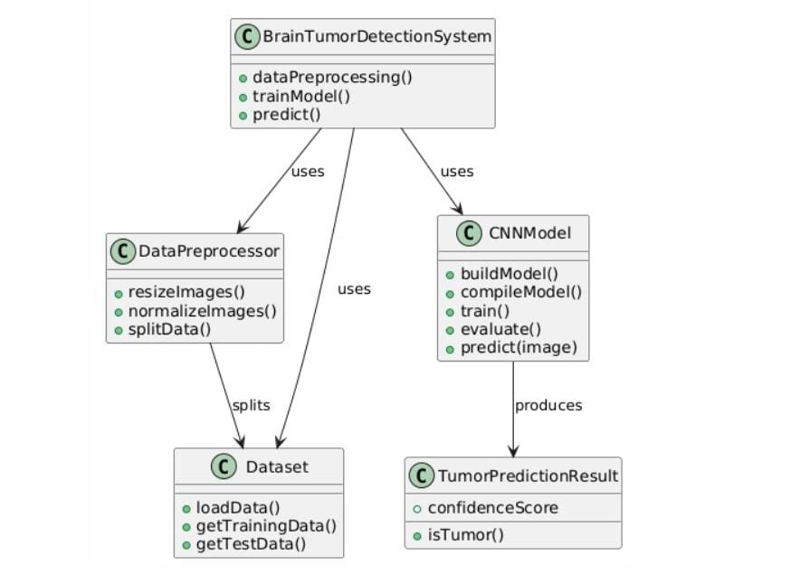
UML Diagrams-Class Diagram

Slide 12
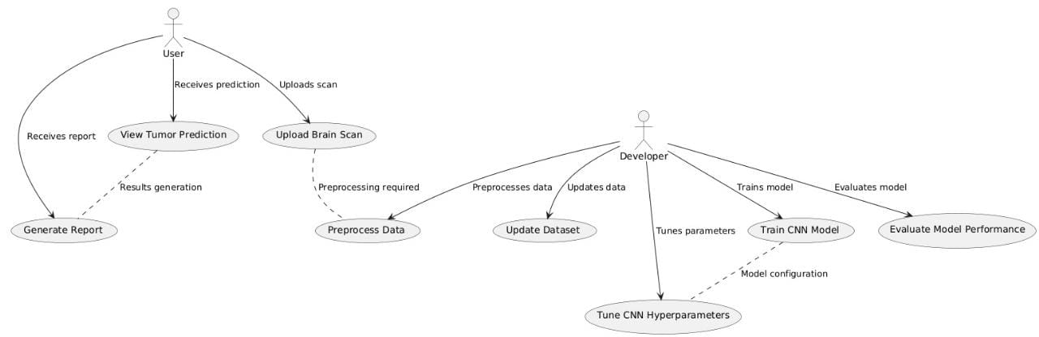
UML Diagrams-Use Case Diagram

Slide 13
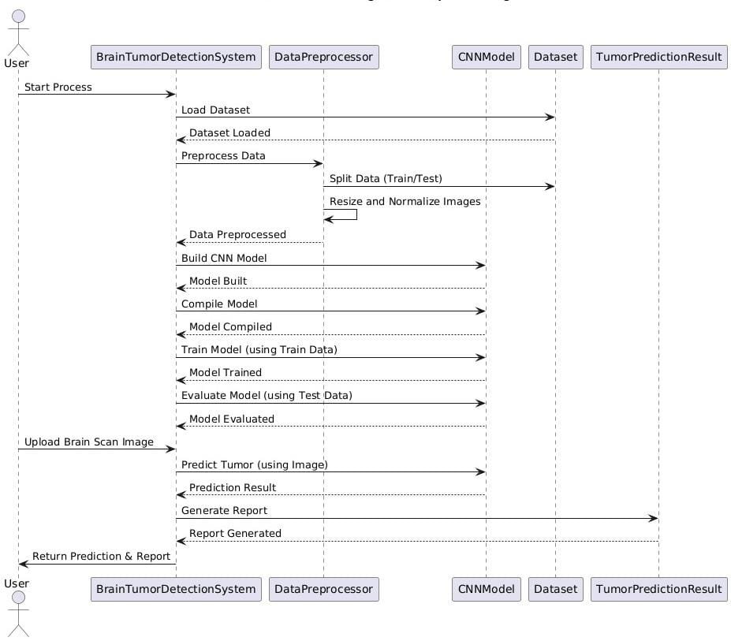
UML Diagrams-Sequence Diagram

Slide 14
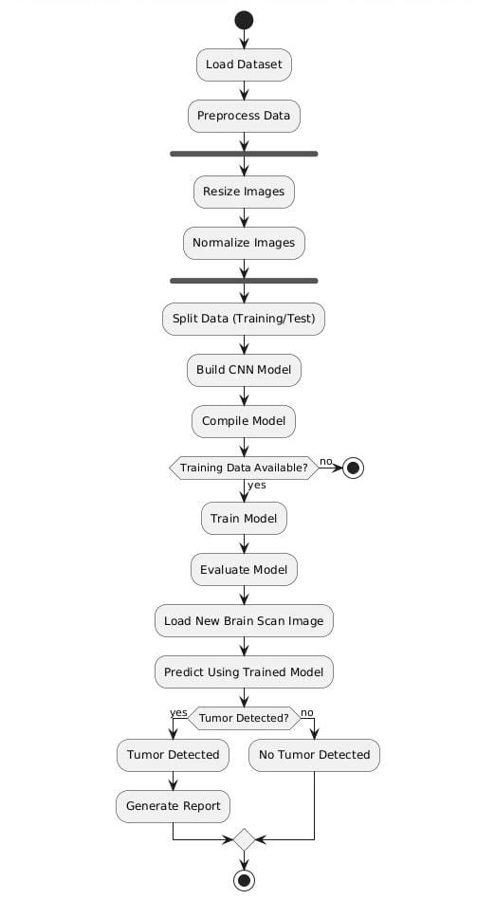
UML Diagrams-Activity Diagram

Slide 15
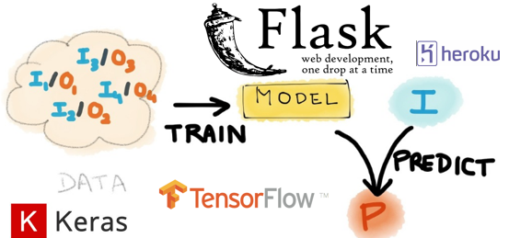
Technologies Used
Python
Machine Learning
Keras
TensorFlow
Flask
HTML/CSS
NumPy

Slide 16

Module Description
OS Module
Flask (render_template, request)
TensorFlow & Keras Modules

Slide 17
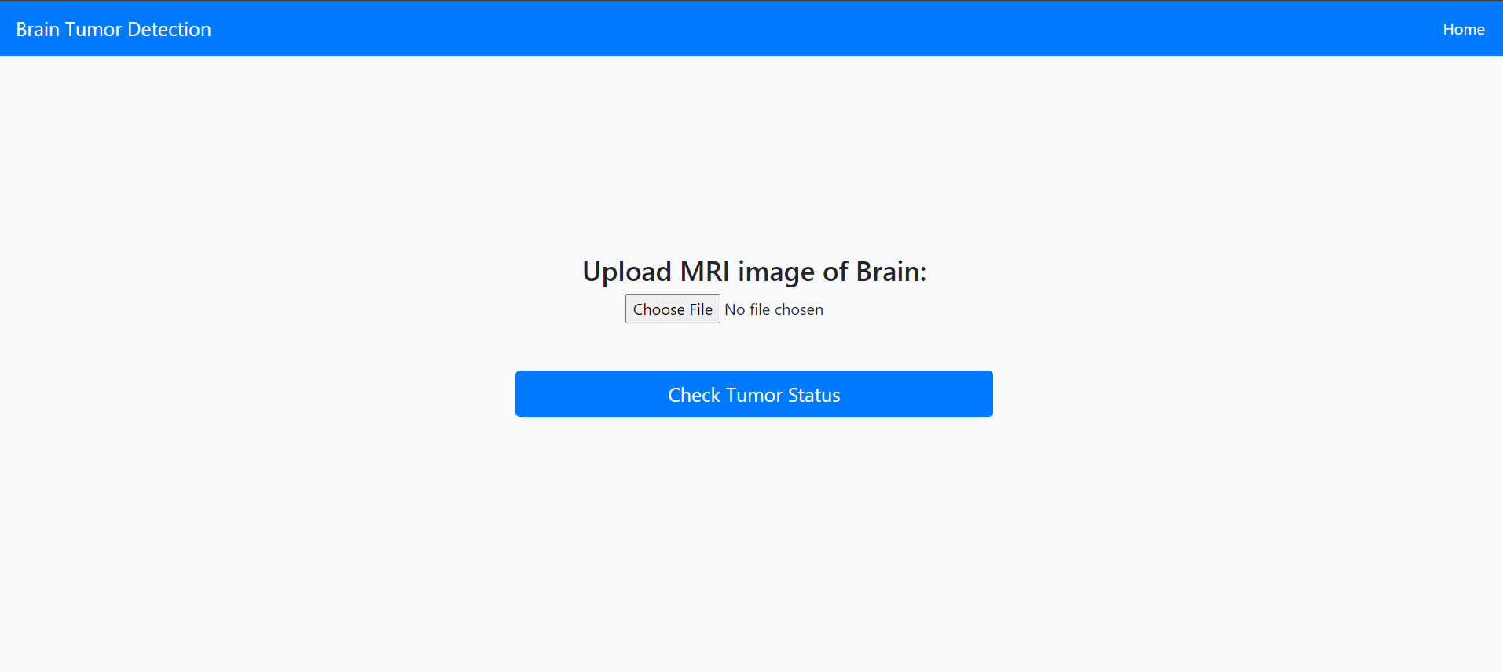
Output Screens

Slide 18
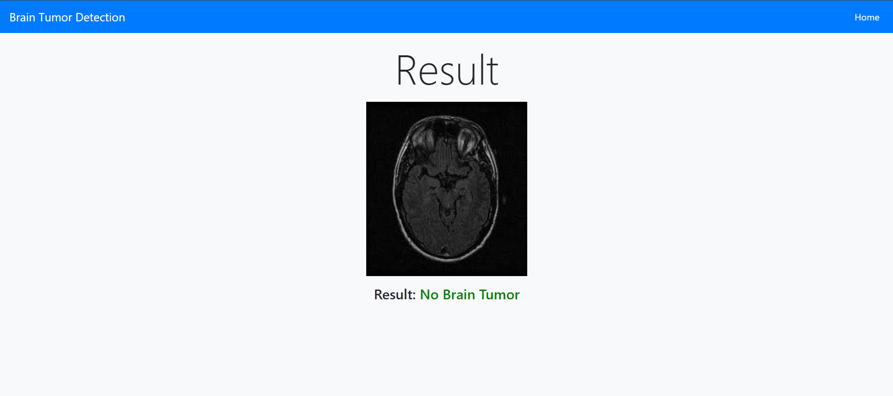
Output Screens

Slide 19
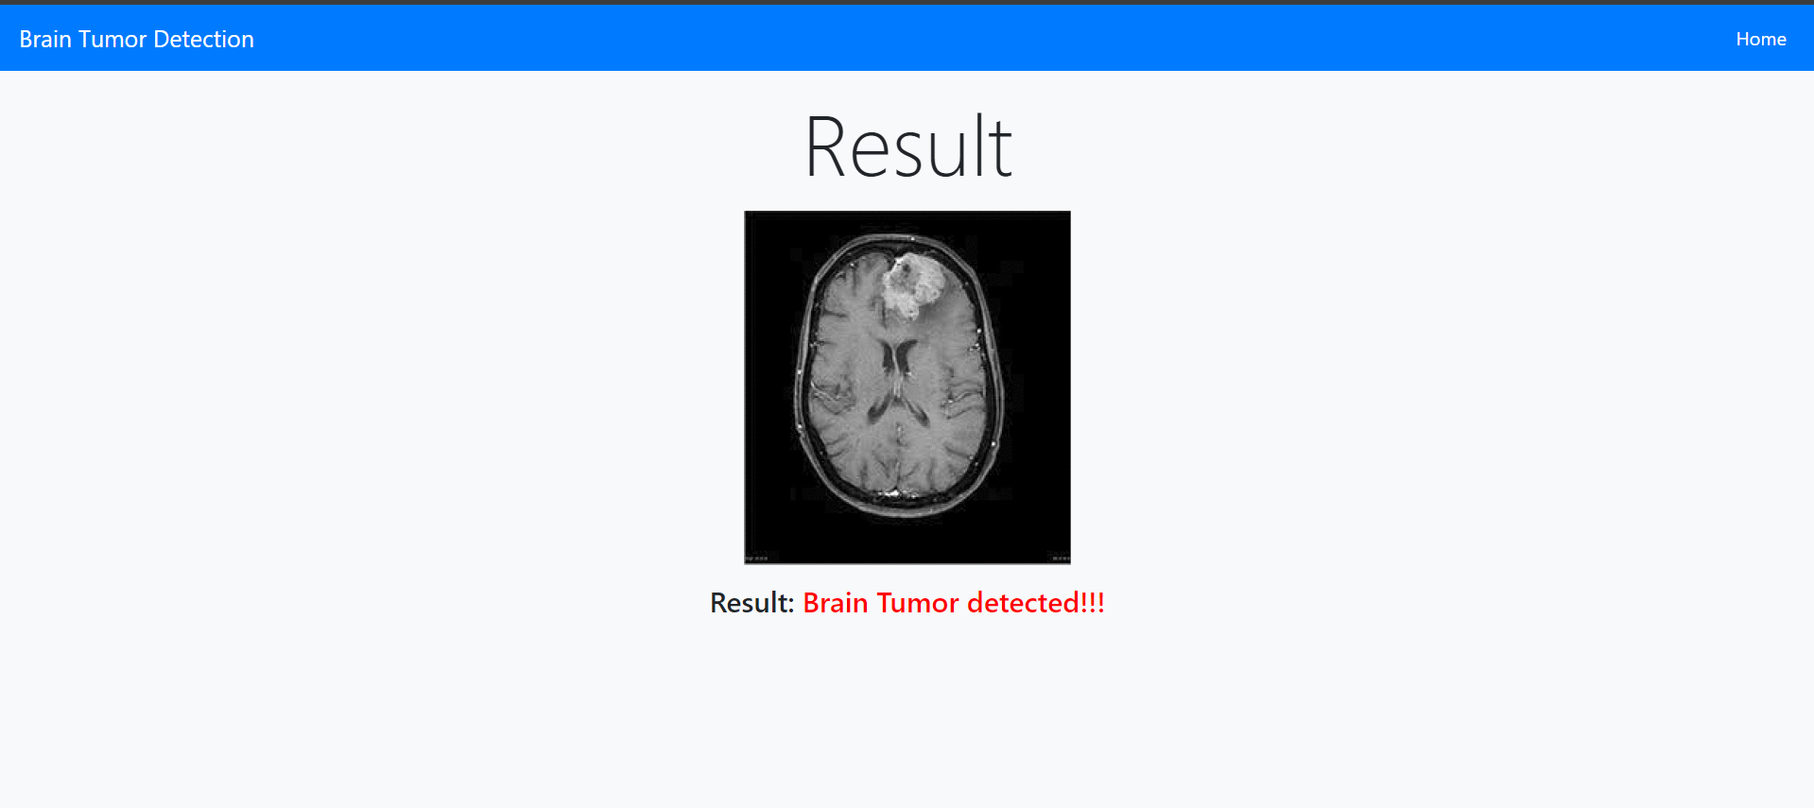
Output Screens

Slide 20
Conclusion
Machine learning, especially CNNs, is transforming brain tumor detection by enabling fast, accurate, and reliable diagnoses from medical imaging. This technology minimizes misdiagnosis, reduces manual analysis, and aids healthcare professionals in making timely decisions for better patient outcomes. Responsible development, with a focus on data privacy and clinical integration, is essential to ensure safe, effective deployment in medical diagnostics.

Slide 21
Future Scope
The future of brain tumor detection through machine learning includes fully automated diagnostic systems, personalized treatment predictions, and real-time monitoring via wearable devices. As models advance, they could be deployed globally, improving diagnostic access in underserved regions. Collaboration across disciplines will drive these innovations, making healthcare more precise, accessible, and proactive.

Slide 22
REFERENCE
The development of the Project was inspired with reference to the current medical sector conditions. According to the IEEE Journal written by Mr. Sanjeev Thakur the Human incapability affects proper decision. The MRI scans for Kaggle platform played a significant role to fulfill the requirements of datasets which was an important part of this project.

Slide 23
THANKYOU

